Slide 1
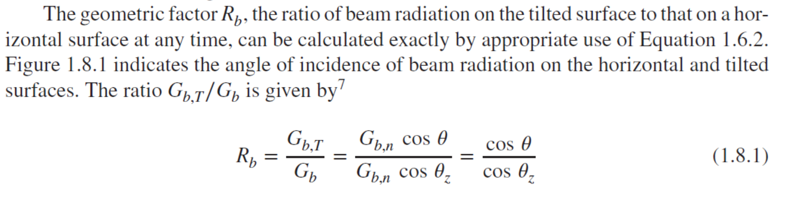

Slide 3
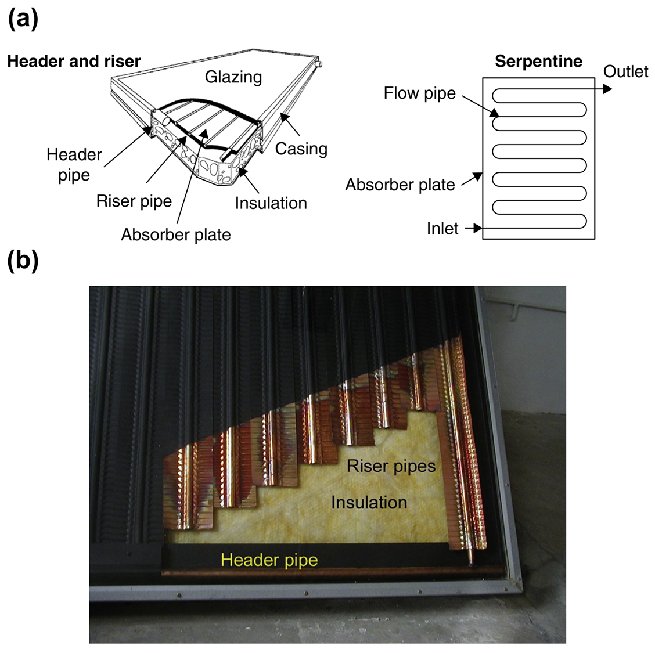
When solar radiation passes through a transparent cover and impinges on the blackened absorber surface of high absorptivity, a large portion of this energy is absorbed by the plate and transferred to the transport medium in the fluid tubes, to be carried away for storage or use. The underside of the absorber plate and the two sides are well insulated to reduce conduction losses.
The liquid tubes are connected at both ends by large-diameter header tubes. The header and riser collector is the typical design for flat-plate collectors. An alternative is the serpentine design shown in Figure 3.1(a). This collector does not present the potential problem of uneven flow distribution in the various riser tubes of the header and riser design, but serpentine collectors cannot work effectively in thermosiphon mode (natural circulation) and need a pump to circulate the heat transfer fluid (see Chapter 5). The absorber plate can be a single sheet on which all risers are fixed, or each riser can be fixed on a separate fin (see Figure 3.1(b)).
The transparent cover is used to reduce convection losses from the absorber plate through the restraint of the stagnant air layer between the absorber plate and the glass. It also reduces radiation losses from the collector because the glass is transparent to the shortwave radiation received by the sun, but it is nearly opaque to longwave thermal radiation emitted by the absorber plate (greenhouse effect).
The advantages of FPCs are that they are inexpensive to manufacture, they collect both beam and diffuse radiation, and they are permanently fixed in position, so no tracking of the sun is required.

Slide 4
The collectors should be oriented directly toward the equator, facing south in the Northern Hemisphere and north in the Southern Hemisphere. The optimum tilt angle of the collector is equal to the latitude of the location, with angle variations of 10 to 15 more or less, depending on the application (Kalogirou, 2003). If the application is solar cooling, then the optimum angle is latitude 10 so that the sun will be perpendicular to the collector during summertime, when the energy will be mostly required. If the application is space heating, then the optimal angle is latitude þ10; whereas for annual hot water production, it is latitude þ5, to have relatively better performance during wintertime, when hot water is mostly required.

Slide 5
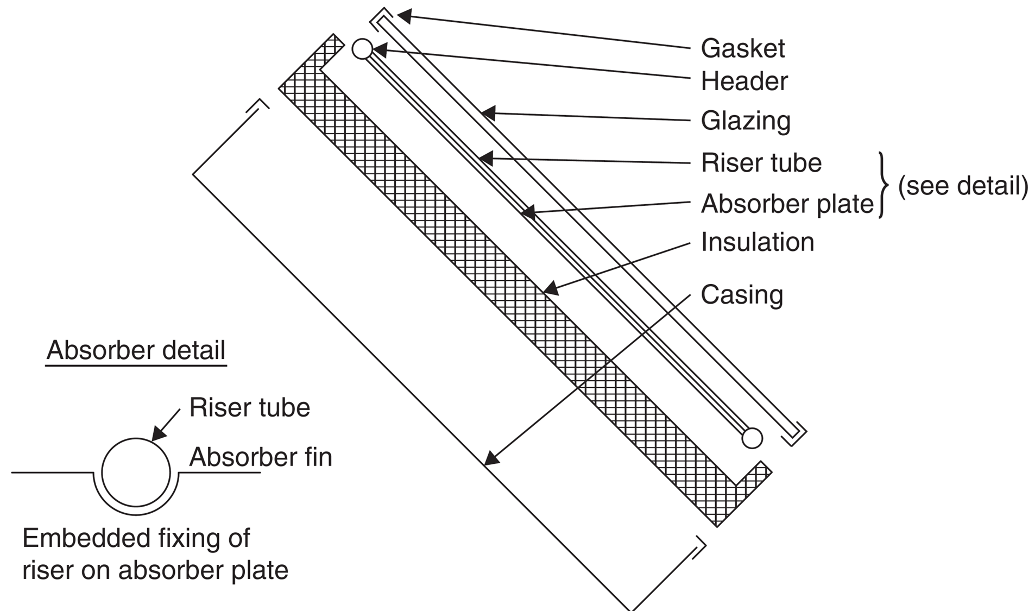
The main components of an FPC, as shown in Figure 3.2, are the following:
Cover. One or more sheets of glass or other radiation-transmitting material.
Heat removal fluid passageways. Tubes, fins, or passages that conduct or direct the heat transfer fluid from the inlet to the outlet.
Absorber plate. Flat, corrugated, or grooved plates, to which the tubes, fins, or passages are attached. A typical attachment method is the embedded fixing shown in the detail of Figure 3.2. The plate is usually coated with a high-absorptance low-emittance layer.
Headers or manifolds. Pipes and ducts to admit and discharge the fluid.
Insulation. Used to minimize the heat loss from the back and sides of the collector.
Container. The casing surrounds the aforementioned components and protects them from dust, moisture, and any other material.
Flat-plate collectors have been built in a wide variety of designs and from many different materials. They have been used to heat fluids such as water, water plus antifreeze additive, or air. Their major purpose is to collect as much solar energy as possible at the lowest possible total cost. The collector should also have a long effective life, despite the adverse effects of the sun’s ultraviolet radiation and corrosion and clogging because of acidity, alkalinity, or hardness of the heat transfer fluid, freezing of water, or deposition of dust or moisture on the glazing and breakage of the glazing from thermal expansion, hail, vandalism, or other causes. These causes can be minimized by the use of tempered glass.

Slide 6
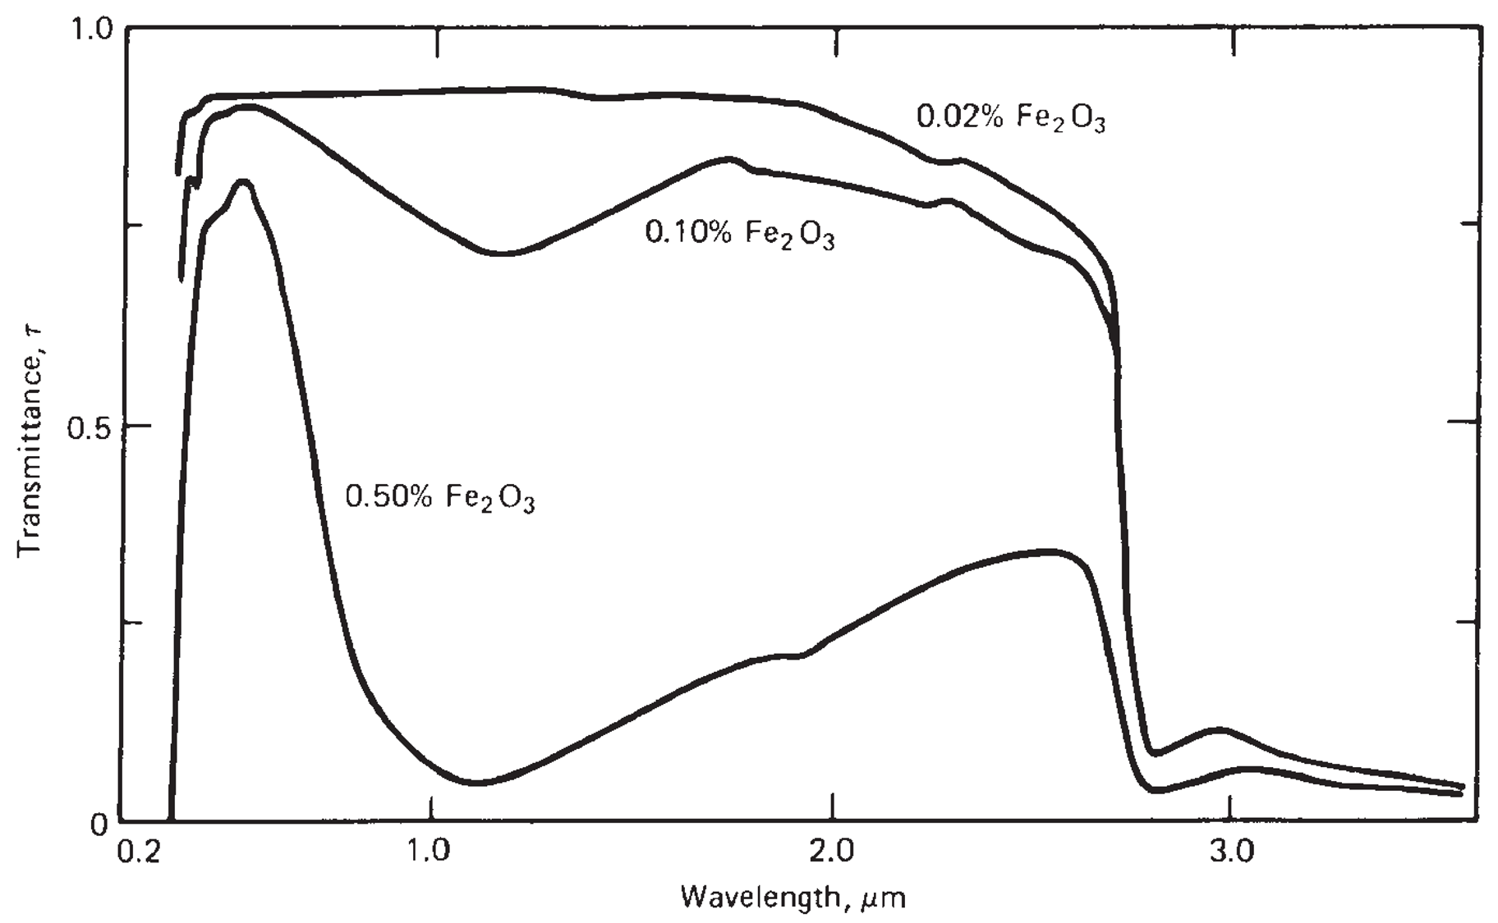
Glazing materials
Glass has been widely used to glaze solar collectors because it can transmit as much as 90% of the incoming shortwave solar irradiation while transmitting virtually none of the longwave radiation emitted outward by the absorber plate (see Example 2.10).Window glass usually has high iron content and is not suitable for use in solar collectors. Glass with low iron content has a relatively high transmittance for solar radiation (approximately 0.85–0.90 at normal incidence), but its transmittance is essentially zero for the longwave thermal radiation (5.0–50 mm) emitted by sun-heated surfaces. Plastic films and sheets also possess high shortwave transmittance, but because most usable varieties also have transmission bands in the middle of the thermal radiation spectrum, they may have longwave transmittances as high as 0.40. Additionally, plastics are generally limited in the temperatures they can sustain without deteriorating or undergoing dimensional changes. Only a few types of plastics can withstand the sun’s ultraviolet radiation for long periods. However, they are not broken by hail or stones, and in the form of thin films, they are completely flexible and have low mass. The commercially available grades of window and greenhouse glass have normal incidence transmittances of about 0.87 and 0.85, respectively (ASHRAE, 2007). For direct radiation, the transmittance varies considerably with the angle of incidence.
Antireflective coatings and surface texture can improve transmission significantly. The effect of dirt and dust on collector glazing may be quite small, and the cleansing effect of an occasional rainfall is usually adequate to maintain the transmittance within 2–4% of its maximum value. Dust is collected mostly during summertime, when rainfall is less frequent, but due to the high magnitude of solar irradiation during this period, the dust protects the collector from overheating.
The glazing should admit as much solar irradiation as possible and reduce the upward loss of heat as much as possible. Although glass is virtually opaque to the longwave radiation emitted by the collector plates, absorption of that radiation causes an increase in the glass temperature and a loss of heat to the surrounding atmosphere through radiation and convection.

Slide 7
Collector absorbing plates
The collector plate absorbs as much of the irradiation as possible through the glazing, while losing as little heat as possible upward to the atmosphere and downward through the back of the casing. The collector plates transfer the retained heat to the transport fluid. To maximize the energy collection, the absorber of a collector should have a coating that has high absorptance for solar radiation (short wavelength) and a low emittance for re-radiation (long wavelength). Such a surface is referred to as a selective surface. The absorptance of the collector surface for shortwave solar radiation depends on the nature and color of the coating and on the incident angle. Usually black color is used.
By suitable electrolytic or chemical treatment, surfaces can be produced with high values of solar radiation absorptance (a) and low values of longwave emittance (ε). Essentially, typical selective surfaces consist of a thin upper layer, which is highly absorbent to shortwave solar radiation but relatively transparent to longwave thermal radiation, deposited on a surface that has a high reflectance and low emittance for longwave radiation. Selective surfaces are particularly important when the collector surface temperature is much higher than the ambient air temperature. The cheapest absorber coating is matte black paint; however, this is not selective, and the performance of a collector produced in this way is low, suitable for operating temperatures not more than 40 C above ambient.
Many methods and materials or material combinations have been used to obtain the desired property of spectral selectivity. The various selective absorbers can be divided into the following categories:
Intrinsic materials or mass absorbers.
Tandem stacks and inverse tandem stacks.
Multilayer stacks (interference stacks).
Metal particles in a dielectric or metal matrix (cermets).
Surface roughness.
Quantum size effects (QSEs).

Slide 8
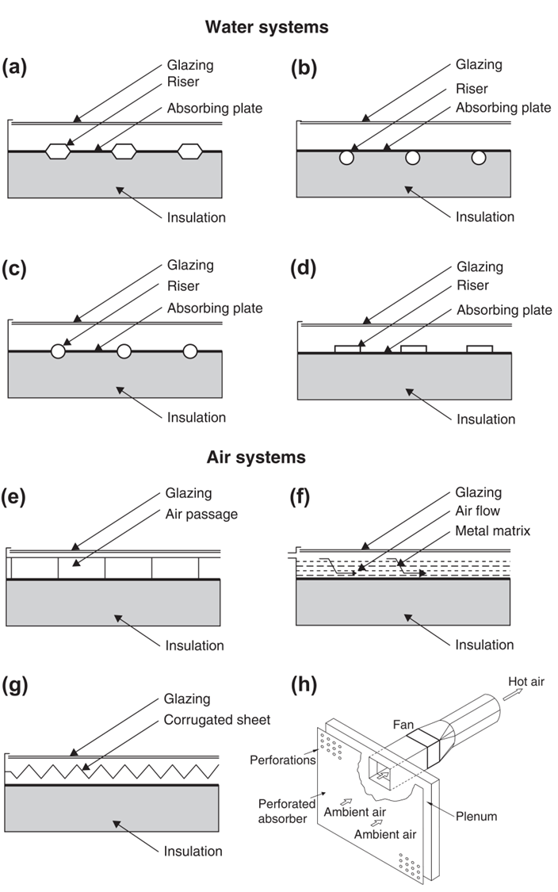
Collector construction
For fluid-heating collectors, passages must be integral with or firmly bonded to the absorber plate. The materials most used for collector plates are copper, aluminum, and stainless steel. UV-resistant plastic extrusions are used for low-temperature applications. The back insulation of a flat-plate collector is made from fiberglass or a mineral fiber mat that will not outgas at elevated temperatures. Building-grade fiberglass is unsatisfactory because the binders evaporate at high temperature and then condense on the collector cover, blocking incoming solar radiation.
Figure 3.3 shows a number of absorber plate designs for solar water and air heaters that have been used with varying degrees of success. Figure 3.3(a) shows a bonded sheet design, in which the fluid passages are integral to the plate to ensure good thermal conduct between the metal and the fluid. Figure 3.3(b) and (c) show fluid heaters with tubes soldered, brazed, or otherwise fastened to upper or lower surfaces of sheets or strips of copper (see also the detail in Figure 3.2). Copper tubes are used most often because of their superior resistance to corrosion and high thermal conductivity.
Thermal cement, clips, clamps, or twisted wires have been tried in the search for low-cost bonding methods. Figure 3.3(d) shows the use of extruded rectangular tubing to obtain a larger heat transfer area between tube and plate. Mechanical pressure, thermal cement, or brazing may be used to make the assembly. Soft solder must be avoided because of the high plate temperature encountered at stagnation conditions, which could melt the solder.

Slide 9
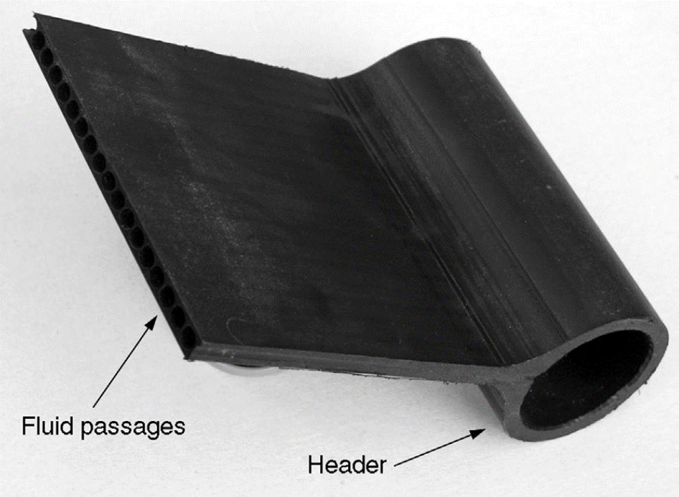
Another category of collectors, which is not shown in Figure 3.3, is the uncovered or unglazed solar collector. These are usually low-cost units that can offer cost-effective solar thermal energy in applications such as water preheating for domestic or industrial use, heating of swimming pools (Molineaux et al., 1994), space heating, and air heating for industrial or agricultural applications. Generally, these collectors are used in cases where the operating temperature of the collector is close to ambient. These collectors, usually called panel collectors, consist of a wide absorber sheet, made of plastic, containing closed-spaced fluid passages (see Figure 3.4). Materials used for plastic panel collectors include polypropylene, polyethylene, acrylic, and polycarbonate.

Slide 10
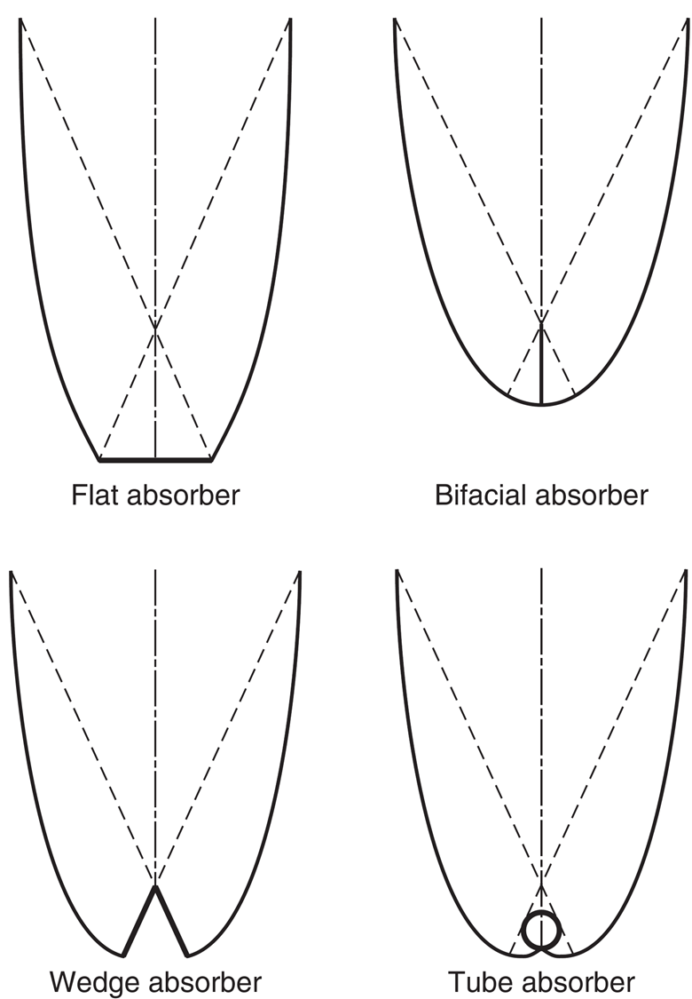
Compound parabolic collectors (CPCs) are non-imaging concentrators. They have the capability of reflecting to the absorber all of the incident radiation within wide limits. Their potential as collectors of solar energy was pointed out by Winston (1974). The necessity of moving the concentrator to accommodate the changing solar orientation can be reduced by using a trough with two sections of a parabola facing each other, as shown in Figure 3.5.
Compound parabolic concentrators can accept incoming radiation over a relatively wide range of angles. By using multiple internal reflections, any radiation entering the aperture within the collector acceptance angle finds its way to the absorber surface located at the bottom of the collector. The absorber can take a variety of configurations. It can be flat, bifacial, wedge, or cylindrical, as shown in Figure 3.5. Details on the collector shape construction are presented in Section 3.6.1. Two basic types of CPC collectors have been designed: symmetric and asymmetric.
CPCs should have a gap between the receiver and the reflector to prevent the reflector from acting as a fin conducting heat away from the absorber. Because the gap results in a loss of reflector area and a corresponding loss of performance, it should be kept small. This is more important for flat receivers.

Slide 11
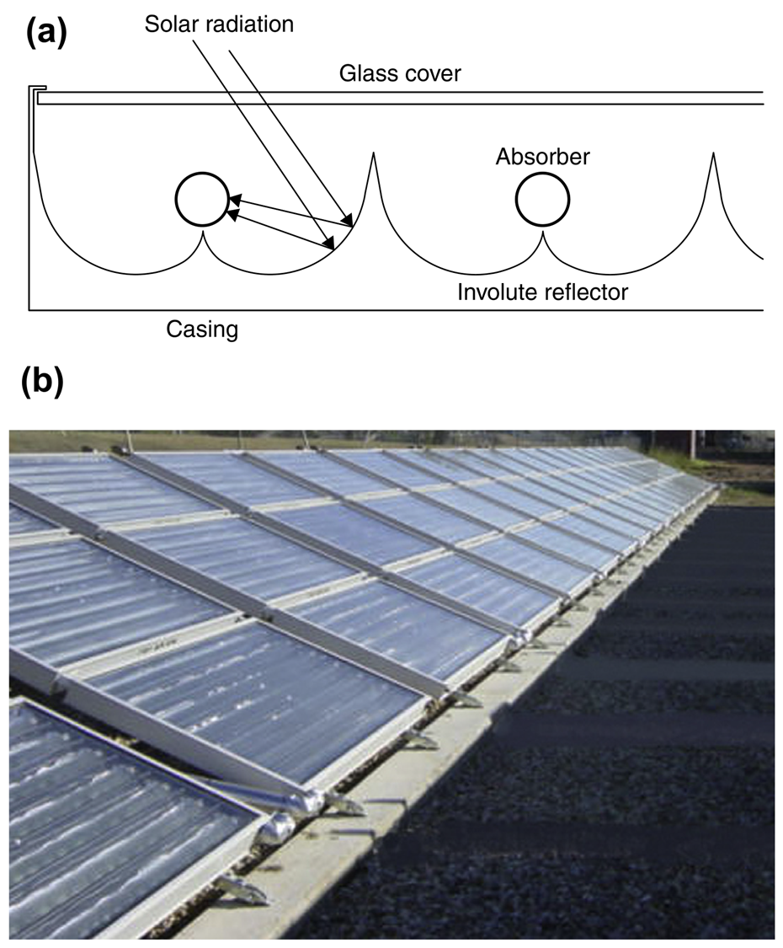
CPCs can be manufactured either as one unit with one opening and one receiver (see Figure 3.5) or as a panel (see Figure 3.6(a)). When constructed as a panel, the collector looks like an FPC, as shown in Figure 3.6(b)..

Slide 12
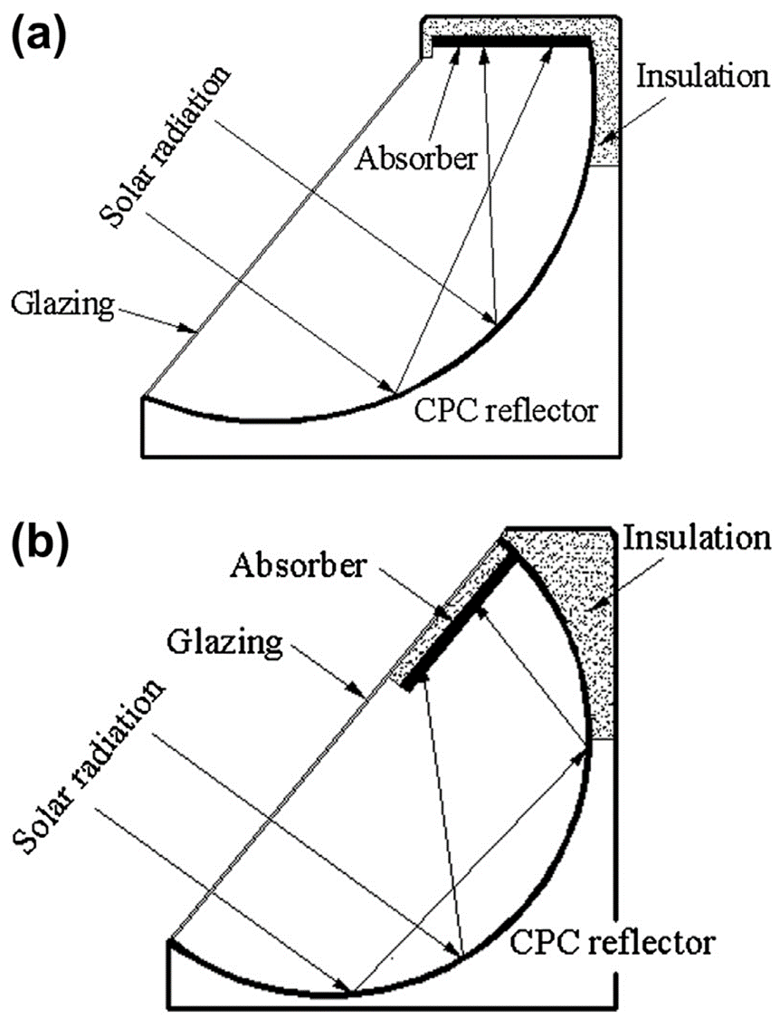
Another category of CPC collectors is the asymmetric type. This can be combined with a reverse or upside down absorber plate configuration. Following the initial investigations on this type of system presented by Kienzlen et al. (1988), in these configurations radiation is directed on the underside of the plate by a stationary concentrator of the CPC shape shown in Figure 3.7(a). In this way, heat losses from the absorber are significantly reduced because the upper side of the plate is well insulated and the convective losses are reduced because the convective current is blocked by the plate itself. Another configuration is the inclined design shown in Figure 3.7(b). Compared with a flat-plate collector, these designs have lower optical efficiency due to the scattering losses in the reflector but better efficiency at higher temperatures.

Slide 13
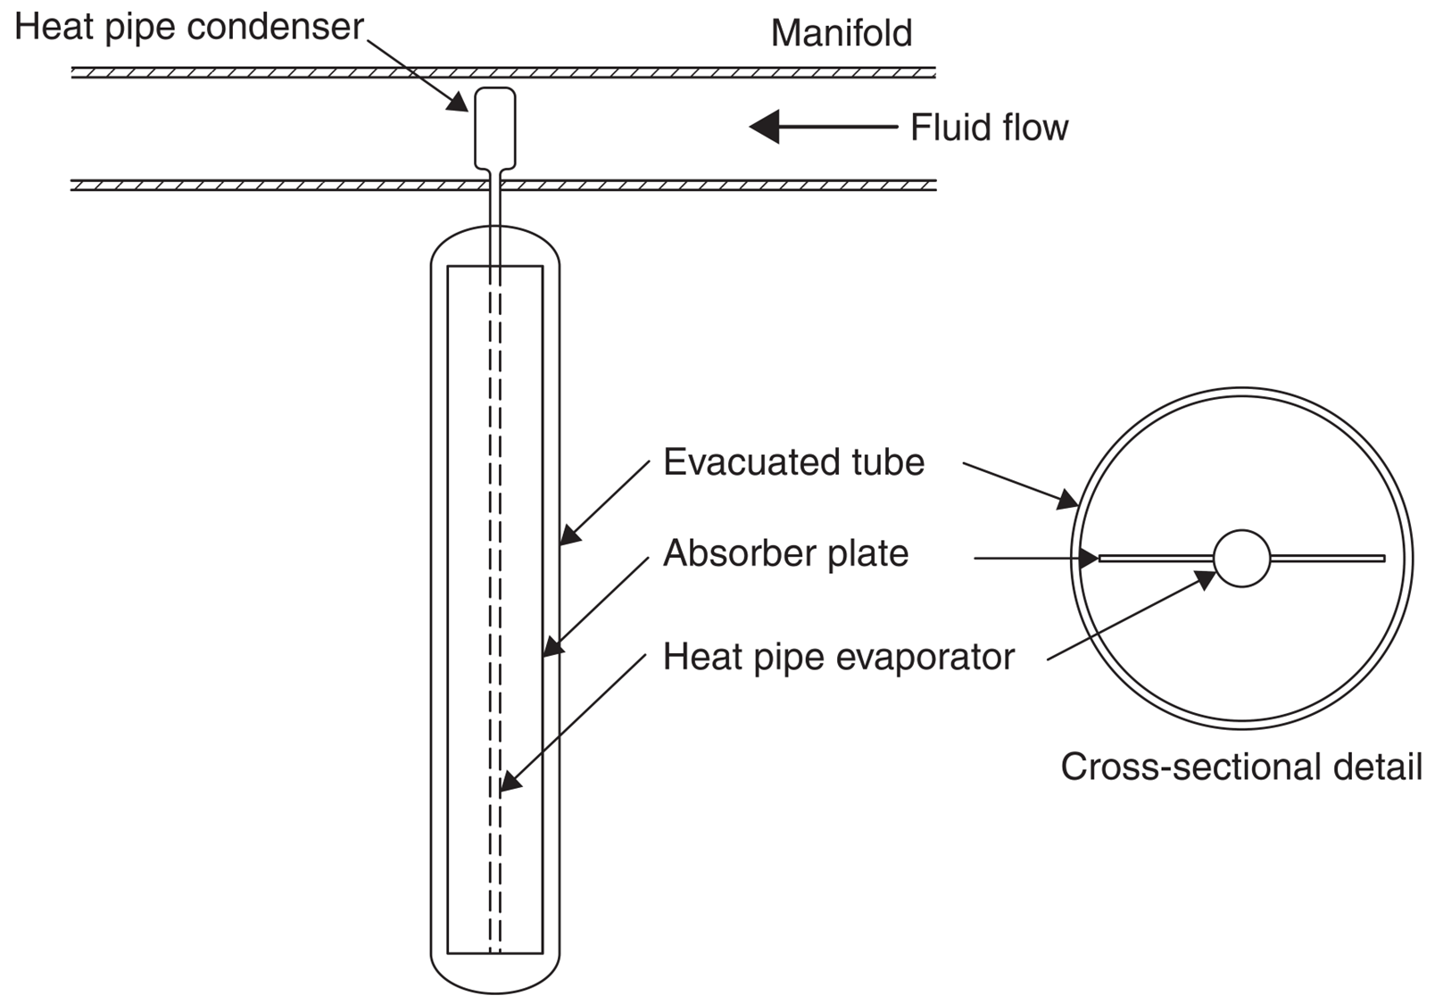
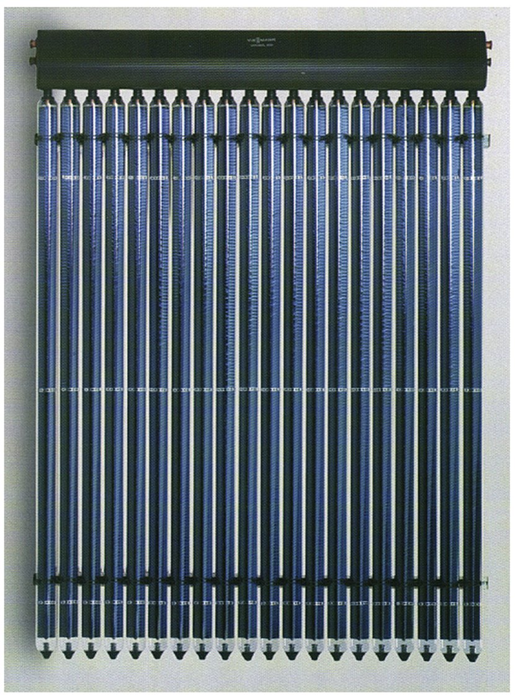
Conventional simple flat-plate solar collectors were developed for use in sunny warm climates. Their benefits, however, are greatly reduced when conditions become unfavorable during cold, cloudy, and windy days. Furthermore, weathering influences, such as condensation and moisture, cause early deterioration of internal materials, resulting in reduced performance and system failure.
Evacuated heat pipe solar collectors (tubes) operate differently than the other collectors available on the market. These solar collectors consist of a heat pipe inside a vacuum-sealed tube, as shown in Figure 3.9. In an actual installation, many tubes are connected to the same manifold as shown in Figure 3.10.
Evacuated tube collectors have shown that the combination of a selective surface and an effective convection suppressor can result in good performance at high temperatures. The vacuum envelope reduces convection and conduction losses, so the collectors can operate at higher temperatures than FPCs. Like FPCs, they collect both direct and diffuse radiation, but their efficiency is higher at low incidence angles. This gives ETCs an advantage over FPCs in terms of daylong performance.

Slide 14
Evacuated tube collectors have shown that the combination of a selective surface and an effective convection suppressor can result in good performance at high temperatures. The vacuum envelope reduces convection and conduction losses, so the collectors can operate at higher temperatures than FPCs. Like FPCs, they collect both direct and diffuse radiation, but their efficiency is higher at low incidence angles. This gives ETCs an advantage over FPCs in terms of daylong performance.
ETCs use liquid–vapor phase change materials to transfer heat at high efficiency. These collectors feature a heat pipe (a highly efficient thermal conductor) placed inside a vacuum-sealed tube. The pipe, which is a sealed copper pipe, is then attached to a black copper fin that fills the tube (absorber plate). Protruding from the top of each tube is a metal tip attached to the sealed pipe (condenser). The heat pipe contains a small amount of fluid (e.g. methanol) that undergoes an evaporating–condensing cycle. In this cycle, solar heat evaporates the liquid and the vapor travels to the heat sink region, where it condenses and releases its latent heat. The condensed fluid returns to the solar collector and the process is repeated. When these tubes are mounted, the metal tip projects into a heat exchanger (manifold), as shown in Figure 3.9. Water or glycol flows through the manifold and picks up the heat from the tubes. The heated liquid circulates through another heat exchanger and gives off its heat to a process or water stored in a solar storage tank. Another possibility is to use the ETC connected directly to a hot water storage tank.
Because no evaporation or condensation above the phase change temperature is possible, the heat pipe offers inherent protection from freezing and overheating. This self-limiting temperature control is a unique feature of the evacuated heat pipe collector.

Slide 15
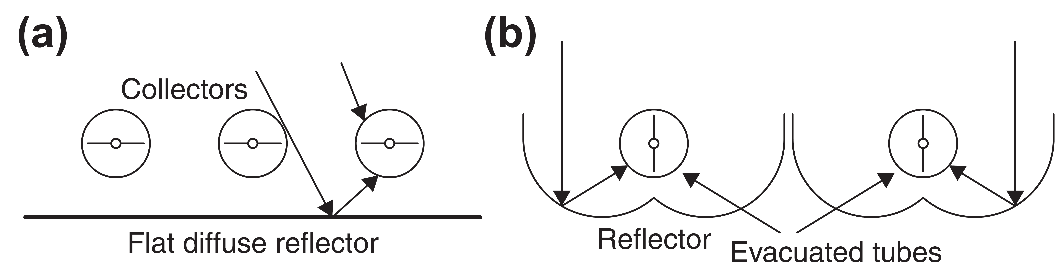
As evacuated tube collectors are relatively expensive, the cost-effectiveness of these collectors can be improved by reducing the number of tubes and using reflectors to concentrate the solar radiation onto the tubes. A diffuse reflector (reflectivity, r ¼ 0.6) mounted behind the tubes, spaced one tube diameter apart, as shown in Figure 3.12(a), increases the absorbed energy in each tube by more than 25% for normal incidence. This system also presents a 10% increase in energy collection over a full day because of incidence angle effects. Greater enhancement per tube can be achieved by using CPC-type reflectors, as shown in Figure 3.12(b). Evacuated tube arrays with stationary concentrators may have stagnation temperatures exceeding 300 °C.

Slide 16
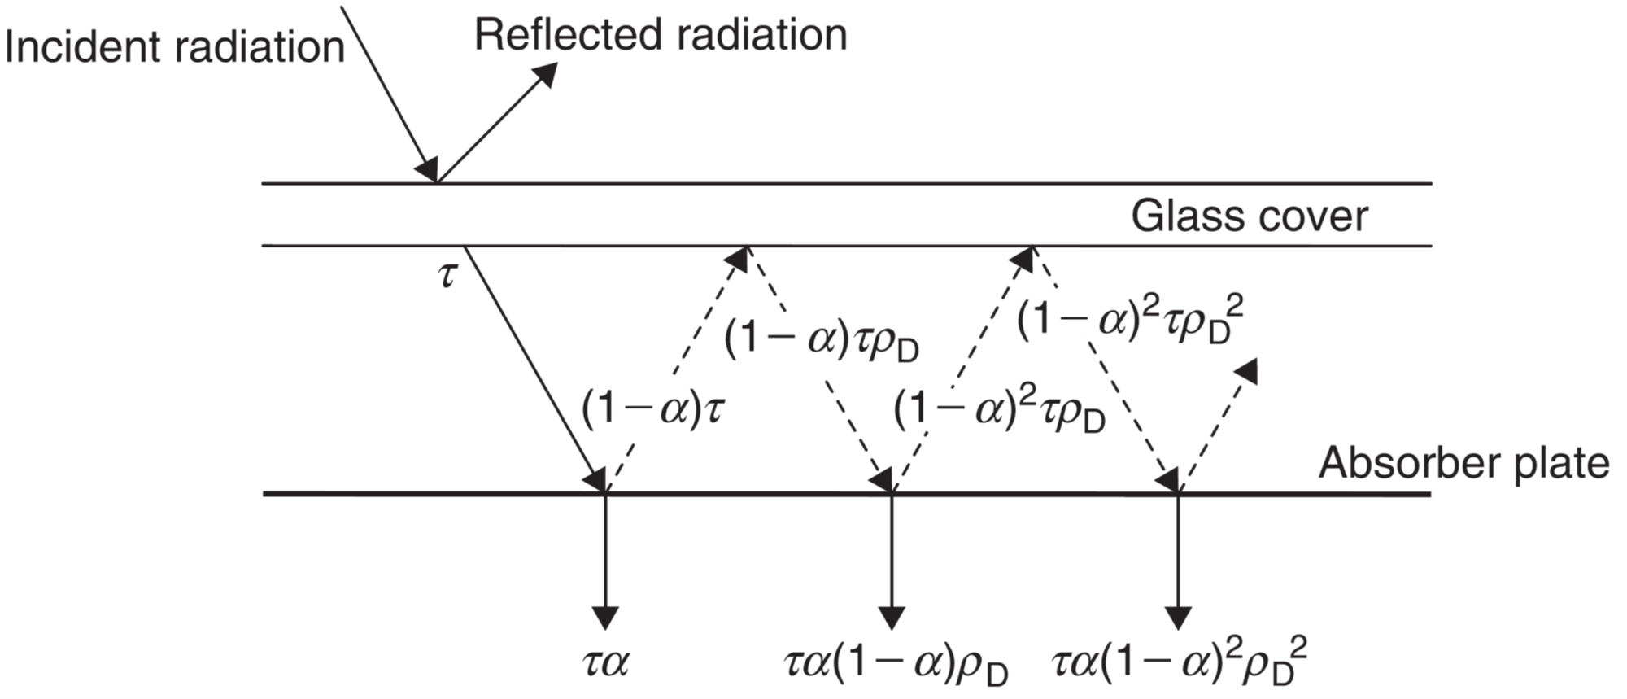
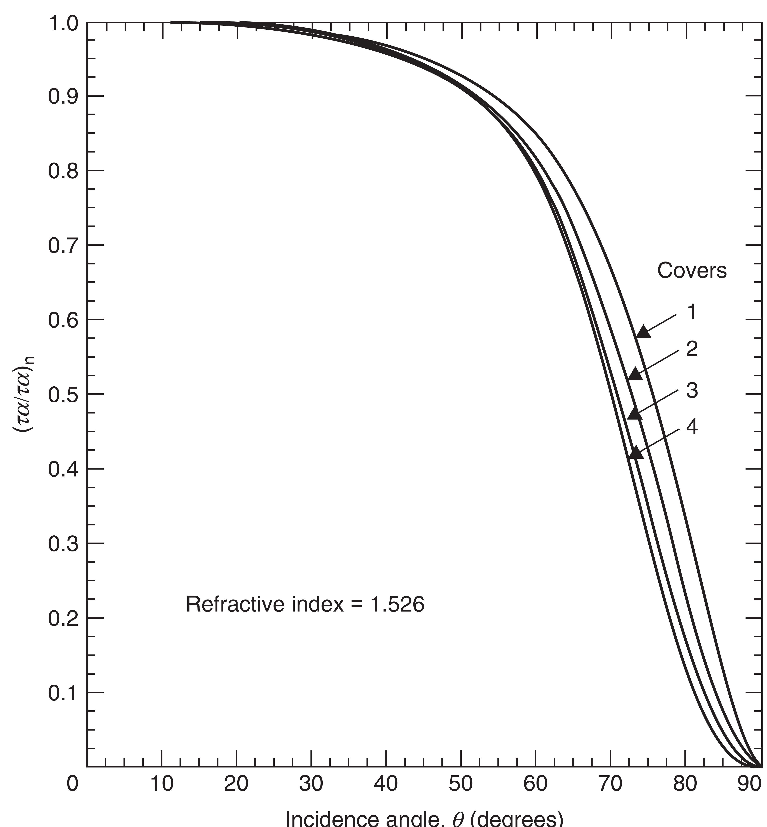
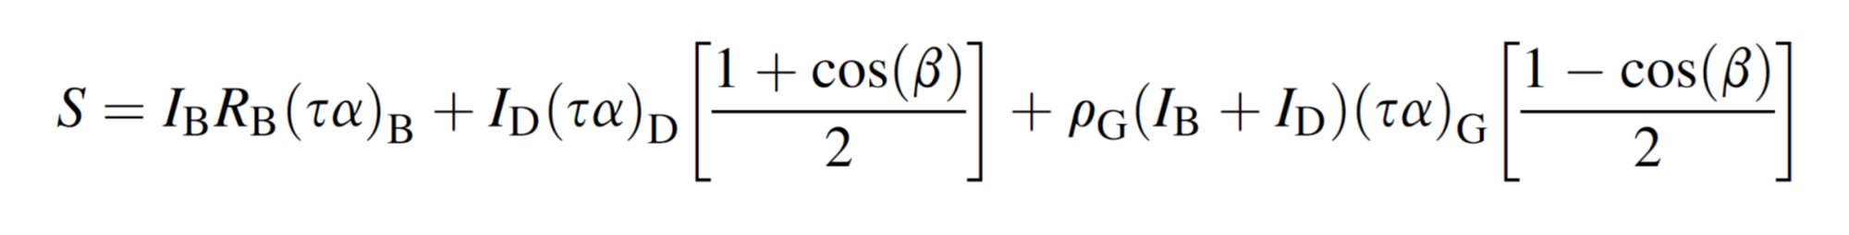

Slide 17
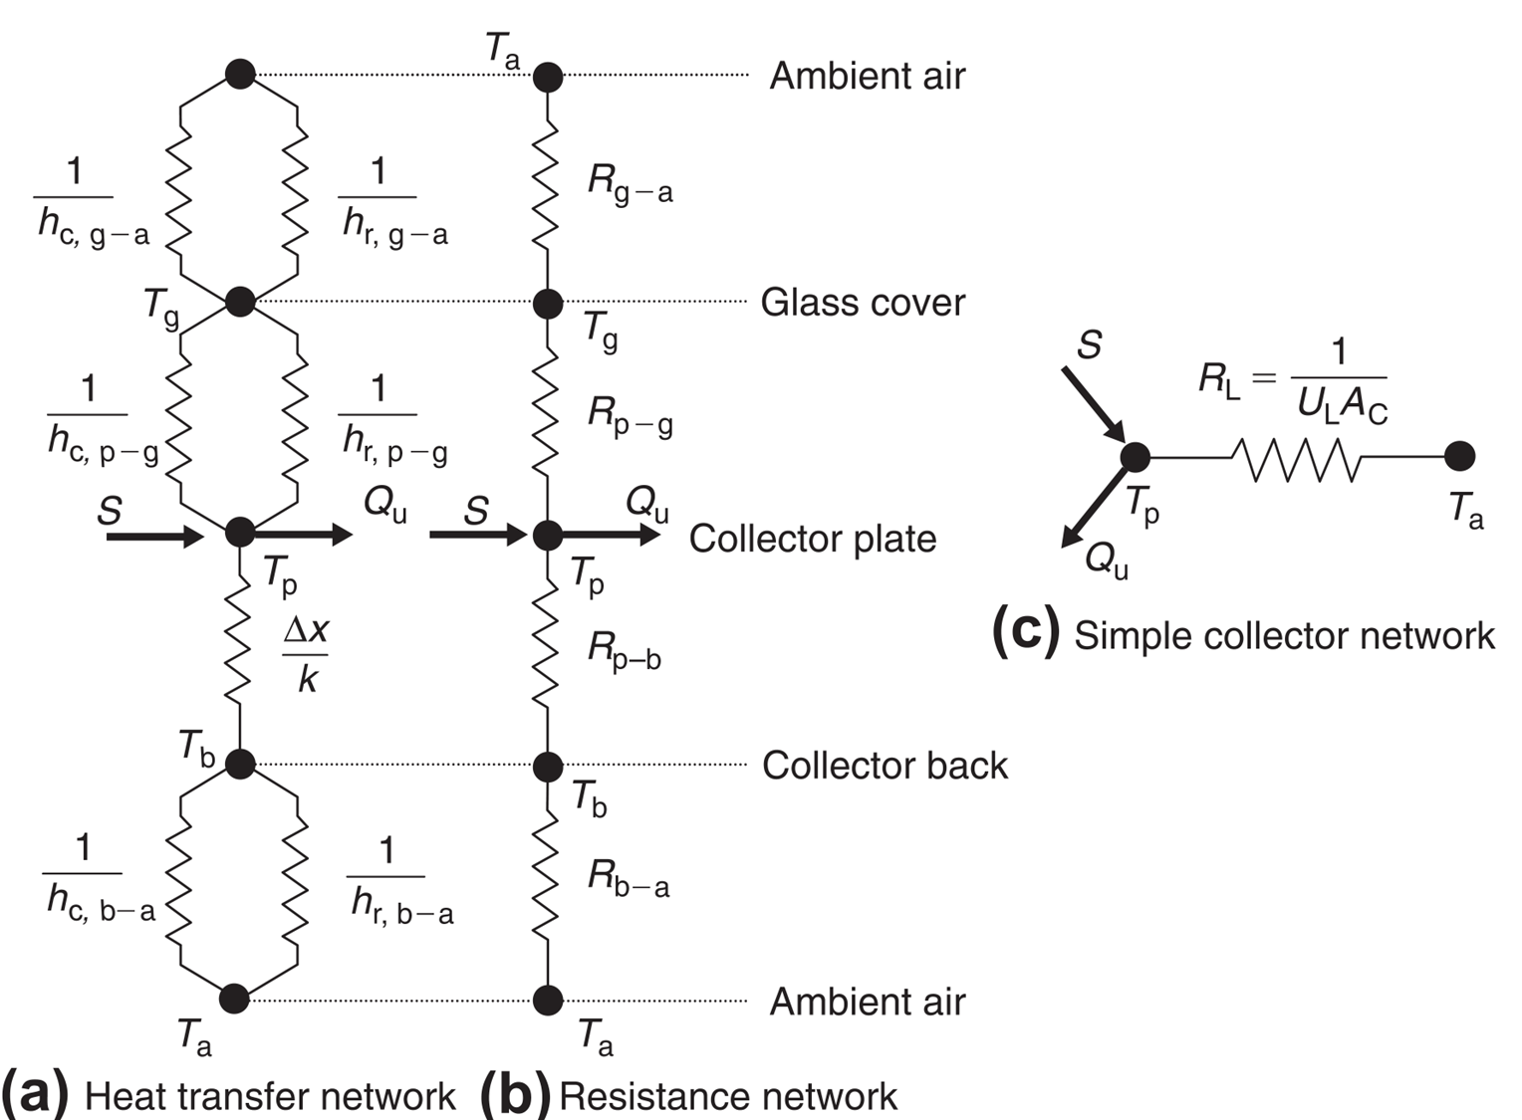
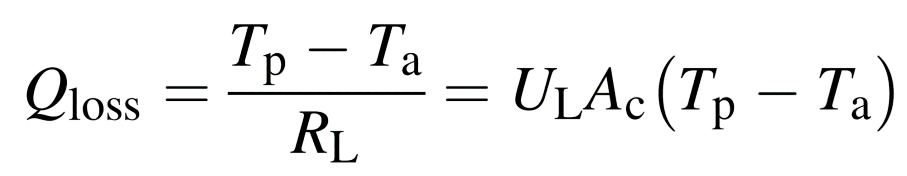

Slide 18
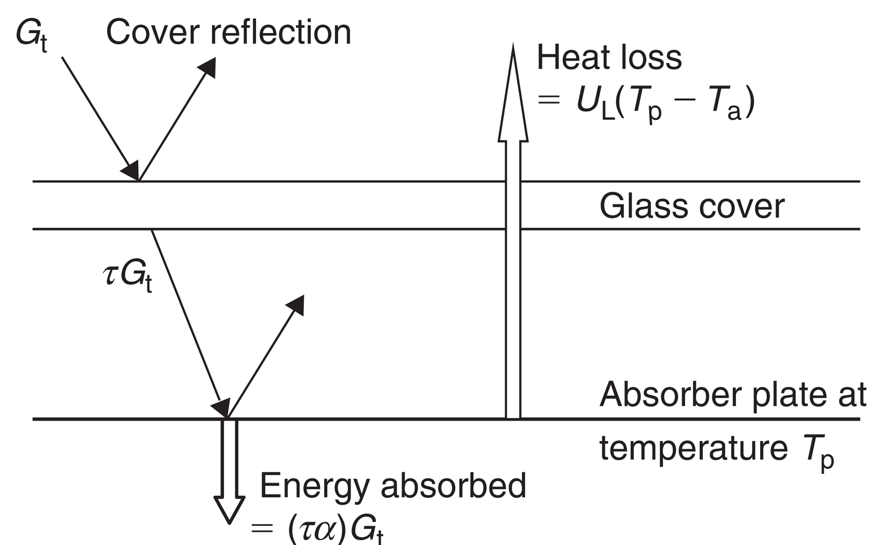
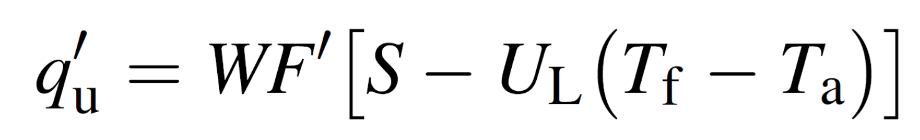
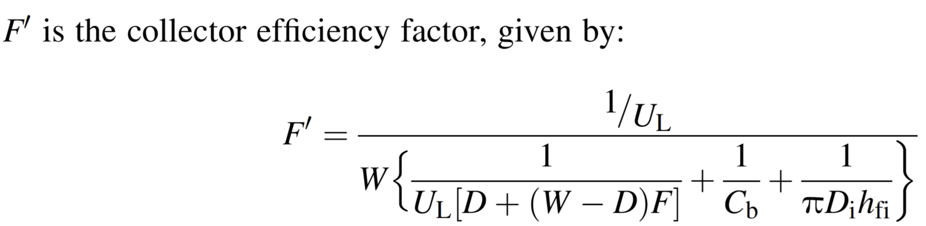
A physical interpretation of F0 is that it represents the ratio of the actual useful energy gain to the useful energy gain that could result if the collector-absorbing surface had been at the local fluid temperature. The collector efficiency factor is essentially a constant factor for any collector design and fluid flow rate.

Slide 19
Heat removal factor represents the ratio of the actual useful energy gain that would result if the collector-absorbing surface had been at the local fluid temperature.

